Slide 1

More on LANs
Module C
Copyright 1998 Panko

Slide 2
More on LANs
More on Ethernet
  802.3 10Base5 and 10Base2
  More on 100Base-TX
  More on gigabit Ethernet
  Ethernet versus 802.3
  Frame Tagging
Bridges versus Switches
More on 802.5 Token-Ring Networks
More on FDDI
802.11 Wireless LANs

Slide 3
Ethernet Recap
Created by Digital Equipment Corporation, Intel, and Xerox
Taken over by the 802.3 Working Group of the IEEE 802 LAN MAN Standards Committee
802.3 has since produced many standards
  Especially at the physical layer: 10Base5, 10Base2, 10Base-T, 100Base-TX, 1000Base-X
  Only one MAC layer standard--the 802.3 MAC layer standard for framing and CSMA/CD

Slide 4
Original Ethernet Versus 802.3 10Base5
Created by Digital, Intel, and Xerox
  Popular version was Ethernet II
802.3 Working Group took over
  Created the first Ethernet standard, 802.3
  Slightly changed the physical layer. Became 10Base-5
  Changed the data link layer (later)
10Base5
  10 Mbps, baseband, 500 meters/segment

Slide 5

Ethernet 10Base5
Multidrop Layout
  Main trunk cable: thick coaxial cable
    Up to 500 meters long
  Drop cable: 15-wire cable
    Up to 50 meters
    Also called the attachment unit interface (AUI)
Drop
Cable
(AUI)
Trunk
Cable
Up to 500 meters

Slide 6
Ethernet 10Base5
Basic Elements
15-Pin DIX
Connector
NIC
Drop Cable
(Attachment Unit Interface or AUI)
50m Maximum
15-Pin DIX
10Base5 Trunk Cable
Connector
(Coaxial Cable)
500m Maximum Per Segment
Transceiver
N-connector
(Medium Attachment Unit or MAU)

Slide 7
Ethernet 10Base5
Broadcast (Bus) Topology
  Station B transmits
  Signal travels down trunk to all other stations
A
B
C

Slide 8
Ethernet 10Base-5
Up to 5 segments connected by repeaters
  2,500 meters maximum distance between farthest stations
  Four repeaters maximum
  No loops
Repeater
Repeater
Drop cable
Segment of Trunk Cable

Slide 9
Ethernet 10Base2 (802.3a)
Cheaper Physical Layer Standard
  NICs have AUI connector
  T-connector attaches to it
  T-connector has AUI connectors for cable runs attaching it to adjacent stations
To next
NIC
To next
NIC
BNC
T-connector
NIC

Slide 10
Ethernet 10Base2 (802.3a)
Segments are thin coaxial cable
  Run only between NICs
  Daisy chain of NICs is a segment
  Terminator at end of each segment
  Up to 30 stations per segment
  5 segments (4 repeaters) maximum
  10Base2: 185 meters/segment
Terminator
NIC
NIC
NIC

Slide 11
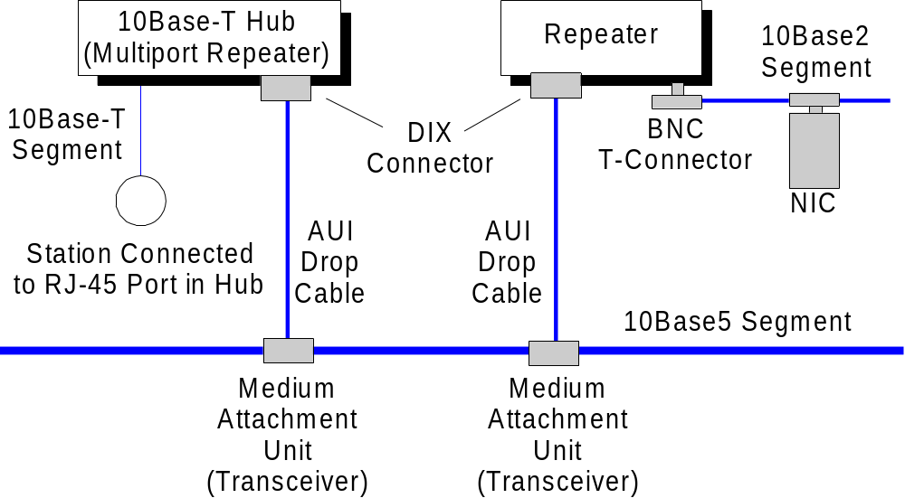
Repeaters can Mix 802.3 PHY Standards

Slide 12
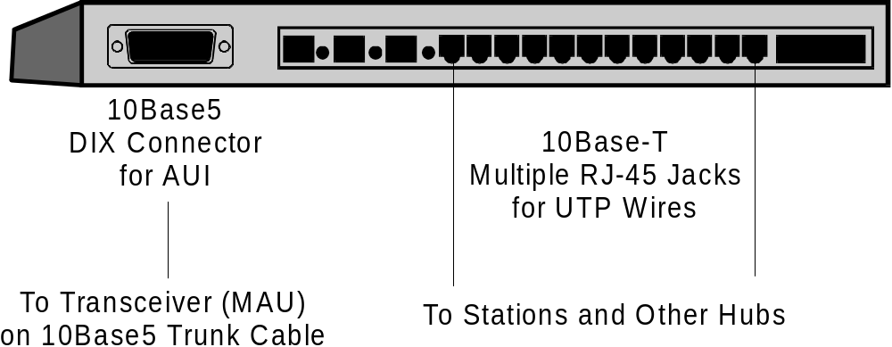
Repeaters can Mix 802.3 PHY Standards
Must have the correct ports
  802.3 10Base2 is often used to link 10/100 Base-T hubs

Slide 13
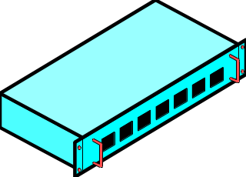
Ethernet with Hubs
Physical Layer Standards
  10Base-T (802.3i)
  100Base-TX and FX (802.3u)
  1000Base-X (gigabit Ethernet) (802.3z, 802.3ab)
Hubs make it easy to find problems
  Disconnect lines until problem is resolved
  In 10Base5 and 10Base2, can be hard to find problems because they may occur anywhere along a segment

Slide 14
100 Mbps Ethernet
Class I Hubs
  Can only have one in a LAN
  Can mix TX and FX connections
Class II Hubs
  Can have two in a LAN
  But must be co-located
  All TX (or all FX)

Slide 15
Gigabit Ethernet
802.3ab UTP wiring, 100 meters maximum
802.3z for optical fiber
  1000Base-SX (short wavelength, 850 nm)
    220-275 meters
  100Base-LX (long wavelength, 1300 nm)
    500 meters multimode fiber
    2 km single-mode fiber

Slide 16
Ethernet II vs 802.3 Frames
Ethernet Frame
  Ethertype field (2 bytes)
  Tells protocol of PDU in data field (e.g., IP)
  No length field
  No 802.2 LLC layer. Full data link layer protocol
Ethernet II Frame
Preamble
SFD
DA
SA
Ethertype
Data
FCS
802.3 Frame
Preamble
SFD
DA
SA
Length
LLC-PDU
FCS

Slide 17
Ethernet II vs 802.3 Frames
Why the Differences
  Lack of a length field could cause problems
  802 would create multiple standards. Giving them all the same connection to the next higher layer (802.2 seemed wise)
Ethernet II Frame
Preamble
SFD
DA
SA
Ethertype
Data
FCS
802.3 Frame
Preamble
SFD
DA
SA
Length
LLC-PDU
FCS

Slide 18
Ethernet II vs 802.3 Frames
Telling them Apart
  NIC must recognize incoming frame’s type
  If 4th field < 1500, must be 802.3 because of maximum length limitation in 802.3
  If 4th field >1500, it’s an Ethertype
Ethernet II Frame
Preamble
SFD
DA
SA
Ethertype
Data
FCS
802.3 Frame
Preamble
SFD
DA
SA
Length
LLC-PDU
FCS

Slide 19
Ethernet Frame Tags
IEEE 802.1 Working Group is Adding “Tag” Fields to Ethernet Headers (and other 802 MAC layer headers)
  Standardize VLANs identification for switches
Ethernet Header
Tag Fields

Slide 20
Ethernet Frame Tags
IEEE 802.1 Working Group is Adding “Tag” Fields to Ethernet Headers (and other 802 MAC layer headers)
  Sets frame priority so that the most time- sensitive frames will get through first
  Not as sophisticated as ATM quality of service, but a major step forward
Ethernet Header
Tag Fields

Slide 21
Frame Tags
Frame Tagging Actually is an 802 Standard
  Will be used in Token-Ring Networks and other 802 standards
  802.2Q is the basic tagging standard
  802.1p specifies how priority is implemented in frame tagging

Slide 22
Bridges versus Switches
802 LANs are Shared Media Networks
  Stations share the speed of the LAN
  Only one can transmit at a time
  Congestion (latency) as number of stations grows

Slide 23
Bridges versus Switches
Bridges
  Connect two 802 LANs
  Only pass cross traffic, so reduces congestion
  Ends distance limitations of single LAN
  (Can even connect 802.3 & 802.5 LANs)
Cross Traffic Only
LAN 1 - LAN 2
LAN 1
LAN 2

Slide 24
Bridges versus Switches
Bridge Limits
  Only a single CPU
  If multiple ports connect multiple LANs, only one can be serviced at a time
  Delays if two pairs of ports are active simultaneously
Bridge
Wait
LAN 2 to LAN 1
LAN 3 to LAN 4
Send
LAN 1
LAN 2
LAN 3
LAN 4

Slide 25
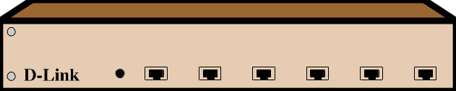
Bridges versus Switches
Switches
  Basically bridges with parallel processing
  Can process two or more pairs of communicating ports simultaneously
  Allows large numbers of ports
Switch
Send
LAN 2 to LAN 1
LAN 3 to LAN 4
Send
LAN 1
LAN 2
LAN 3
LAN 4

Slide 26
Bridges versus Switches
Switches
  Implement VLANs. Bridges do no.
Switches have largely driven bridges out of the marketplace
Bridges are only sold in two-to-four port versions when they can be purchased at all

Slide 27
802.5 Token-Ring Networks
Differential Manchester Encoding
  For a 1
    No transmission at start of bit period
    Transition in middle
  For a 0
    Transition at start of bit period
    Transition in middle

Slide 28
802.5 Token-Ring Networks
Differential Manchester Encoding
  For a J
    No transmission at start of bit period
    No transition in middle
  For a K
    Transition at start of bit period
    No transition in middle

Slide 29
802.5 Token-Ring Networks
Differential Manchester Encoding
No Transition
at Start
Transition
at Start
Transition
in Middle
1
0
No Transition
in Middle
J
K

Slide 30
Token Frame in 802.5
Start Frame Delimiter (JK0JK000) [1 octet]
Access Control (PPPTMRRR) (T=1 for token frame) [1 octet]
End Frame Delimiter (JK1JK1IE) [1 octet]
PPP gives the priority of the token
T=1 for a token, 0 for a full frame
M is set to 0 by the sending station, to 1 by the monitor station; if the bit is not changed, there has been a problem

Slide 31
Token Frame in 802.5
Start Frame Delimiter (JK0JK000) [1 octet]
Access Control (PPPTMRRR) (T=1 for token frame) [1 octet]
End Frame Delimiter (JK1JK1IE) [1 octet]
In the End Frame Delimiter …
I=1 in a single frame or the last frame of the series; otherwise set to 0
E=0 initially. Set to 1 by any station detecting an error

Slide 32
Token Frame in 802.5
Start Frame Delimiter (JK0JK000) [1 octet]
Access Control (PPPTMRRR) (T=1 for token frame) [1 octet]
End Frame Delimiter (JK1JK1IE) [1 octet]
In the End Frame Delimiter …
I=1 in a single frame or the last frame of the series; otherwise set to 0
E=0 initially. Set to 1 by any station detecting an error

Slide 33
Full 802.5 Frame
Start Frame Delimiter (JK0JK000) [1 octet]
Access Control (PPPTMRRR) (T=0 for full frame) [1 octet]
Frame Control (FFZZZZZZ) Type of Frame [1 octet]
FF tells type of frame
  01 if contains 802.2 LLC PDU (data)
  00 for supervisory frames
ZZZZZZ tells specific type of frame

Slide 34
Full 802.5 Frame
Start Frame Delimiter (JK0JK000) [1 octet]
Access Control (PPPTMRRR) (T=0 for full frame) [1 octet]
Frame Control (FFZZZZZZ) Type of Frame [1 octet]
Destination Address [6 octets]
Source Address [6 octets]
Addresses are the same as in 802.3
48-bits long

Slide 35
Full 802.5 Frame
Earlier Fields
Routing Information for Source Route Bridges [2-6 octets]
Information
Frame Check Sequence [4 octets]
Information field can be up to 17,997 octets for 16 Mbps Token Ring Networks
Frame Check Sequence identical to 802.3 FCS field

Slide 36
802.5 Full Frame
Earlier Fields
End Frame Delimiter (JK1JK1IE) [1 octet]
Frame Status (ACrrACrr)
End Frame Delimiter as in Token Frame
Frame Status for Reporting Specific Errors
  A(ddress): If receiving station recognizes its address, changes from 0 to 1
  C(opy): if receiving station copies the frame successfully, changes 0 to 1

Slide 37
Error Handling in 802.5
Lost Token
  There is an active monitor station that checks for problems
  If active monitor does not correct the problem, another station assumes the role of active monitor
  Complex. Adds to cost.

Slide 38
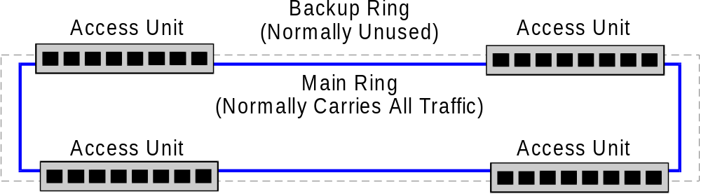
Error Handling in 802.5
Repairing Breaks in the Ring
  A single break makes the ring useless
  Really a dual ring. Normally, only one used

Slide 39
Error Handling in 802.5
If there is a break, the ring is wrapped
  Still forms a closed loop
  Can only be done once, so breaks should be fixed promptly
Access Unit
Wrapped Ring
Access Unit
Access Unit
Access Unit
Break

Slide 40
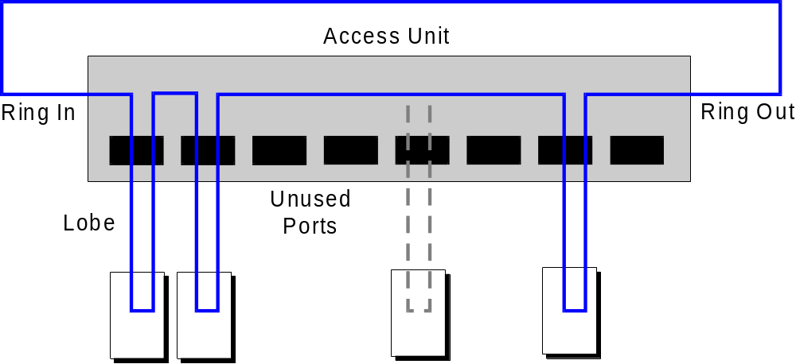
Within an 802.5 Access Unit
Access unit connections maintain a ring (loop)

Slide 41
Within an 802.5 Access Unit
When stations power up, they are connected automatically

Slide 42
Within an 802.5 Access Unit
When stations power down, they are disconnected automatically

Slide 43
FDDI Networks
Fiber Distributed Data Interface
  American National Standards Institute (ANSI)
  Token-ring technology
    Based on 802.5 but incompatible
  100 Mbps
  Maximum circumference of 200 km
  Has been popular as backbone technology to link LANs in a site network
  Being pushed out by switching, which is more flexible and offers a greater range of speeds

Slide 44
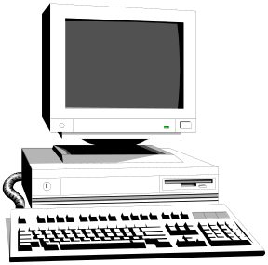
802.11 Wireless LANs
Wireless Technologies for LANs
  Radio
  Infrared light (as in remote control)
  Ideal for mobile devices
  Useful when wiring would be costly

Slide 45
802.11 Wireless LAN Standards
Standards come from the 802.11 Working Group
  Have already defined 1 Mbps and 2 Mbps standards for radio
  Higher speeds will be coming

Slide 46
802.11 Wireless LANs
Mode
  Direct: peer-to-peer
  Control point to govern interactions
Control Point

Slide 47
802.11 Wireless LANs
Media Access Control
  CSMA/CA
  CSMA with Collision Avoidance
    Tries to avoid collisions
  When line is clear, station may send (CSMA),
  but before it sends, must wait a random amount of time
  This prevents stations that have been waiting to transmit from all transmitting at once when the currently transmitting station is finished

Slide 48
802.11 Wireless LANs
Media Access Control
  When a frame is received correctly, the receiver immediately sends back an acknowledgement
  This allows the sender to know if it needs to resend
Frame
ACK

